Slide 1
DBMS FOR LIBRARY MANAGEMENT
TEAM:
Akash B
Ankita KR
Abhijit K
Amrutha A

Slide 2
Problem Statement
Build a web application using web2py
Which includes Adding, Updating ,searching of information about students and Library Books.

Slide 3
Client details
Chinmaya Degree College, Mayuri Estate, Hubli
Smt. Rajanikanthi Tungal [Principal]

Slide 4
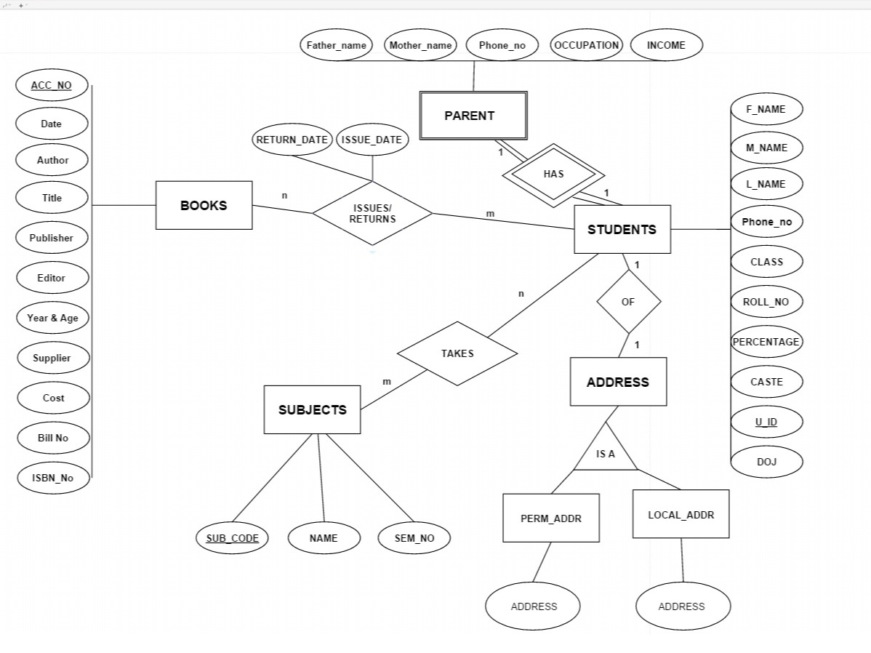
ER DIAGRAMS
ER-1

Slide 5
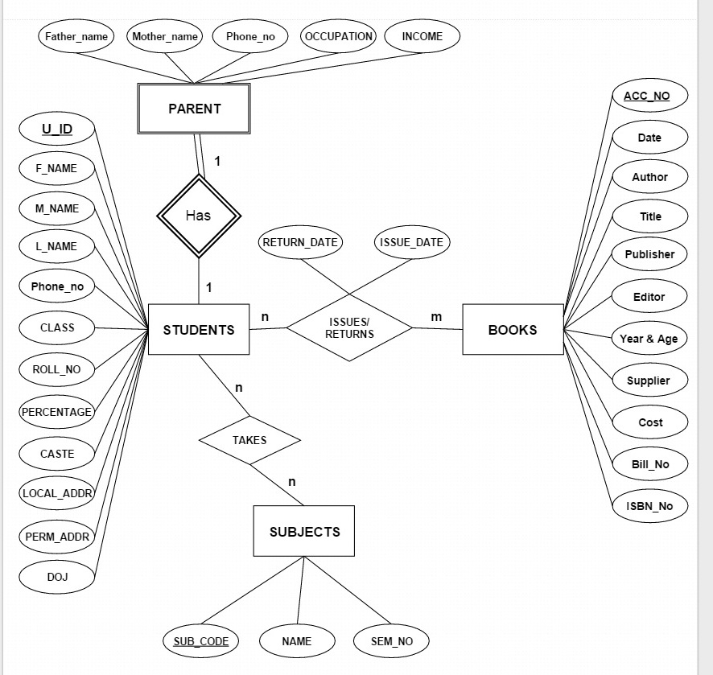
ER-2

Slide 6
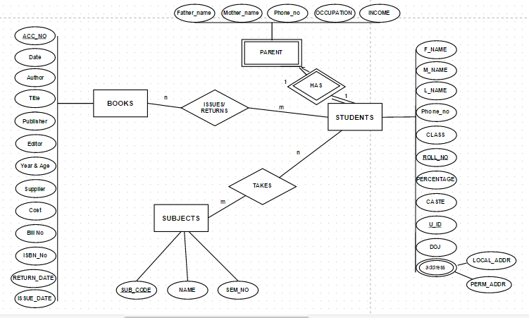
ER-3

Slide 7
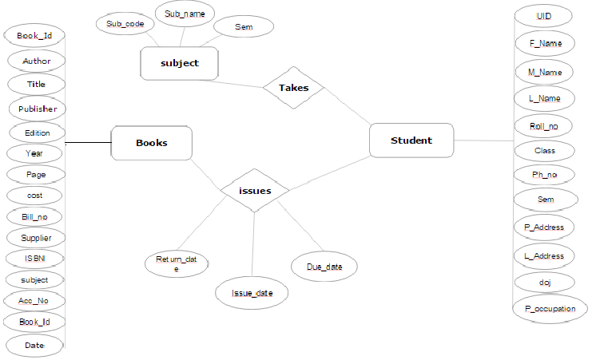
OPTIMAL ER

Slide 8
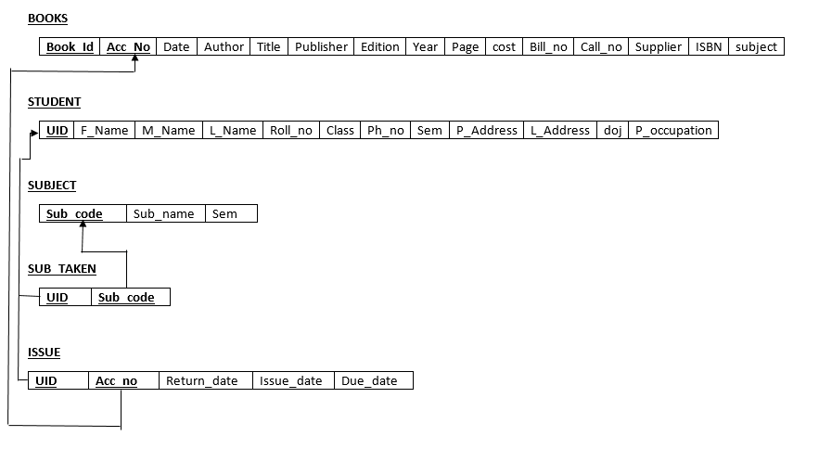
Normalized relational schema

Slide 9
SQL QUERIES IN THE APPLICATION
web2py comes with a Database Abstraction Layer (DAL), an API that maps Python objects into database objects such as queries, tables, and records. The DAL dynamically generates the SQL in real time using the specified dialect for the database back end, so that you do not have to write SQL code or learn different SQL dialects
Driver used:sqlite

Slide 10
Creating Tables
EXAMPLE: STUDENT TABLE -
db.define_table(
'student_info',
Field('u_id','string',requires=[IS_NOT_EMPTY(),IS_NOT_IN_DB(db,'student_info.u_id')]),
Field('F_name','string',requires=IS_NOT_EMPTY()),
Field('M_name','string',requires=IS_NOT_EMPTY()),
Field('L_name','string',requires=IS_NOT_EMPTY()),
Field('Roll_no','string',requires=IS_NOT_EMPTY()),
Field('Class_','string',requires=IS_NOT_EMPTY()),
Field('sem','string',requires=IS_NOT_EMPTY()),
Field('l_address','text',requires=IS_NOT_EMPTY()),
Field('l_phone_no','string',requires=IS_NOT_EMPTY()),
Field('p_address','text',requires=IS_NOT_EMPTY()),
Field('p_phone_no','string',requires=IS_NOT_EMPTY()),
Field('doj_date','date',requires=IS_NOT_EMPTY()),
Field('p_occupation','string',requires=IS_NOT_EMPTY()))

Slide 11
Queries Executed
rows=db(db.student_info.F_name==(request.vars.name)).select(db.student_info.ALL)
call=db(db.Book_acc.Book_id==(request.vars.name)).select(db.Book_acc.Book_id,db.Book_acc.Acc_no,db.Book_acc.call_no)
db(db.ISSUE.Acc_no==(request.vars.name1))(db.ISSUE.u_id==(request.vars.name3)).update(Return_date=(request.vars.name2))

Slide 12
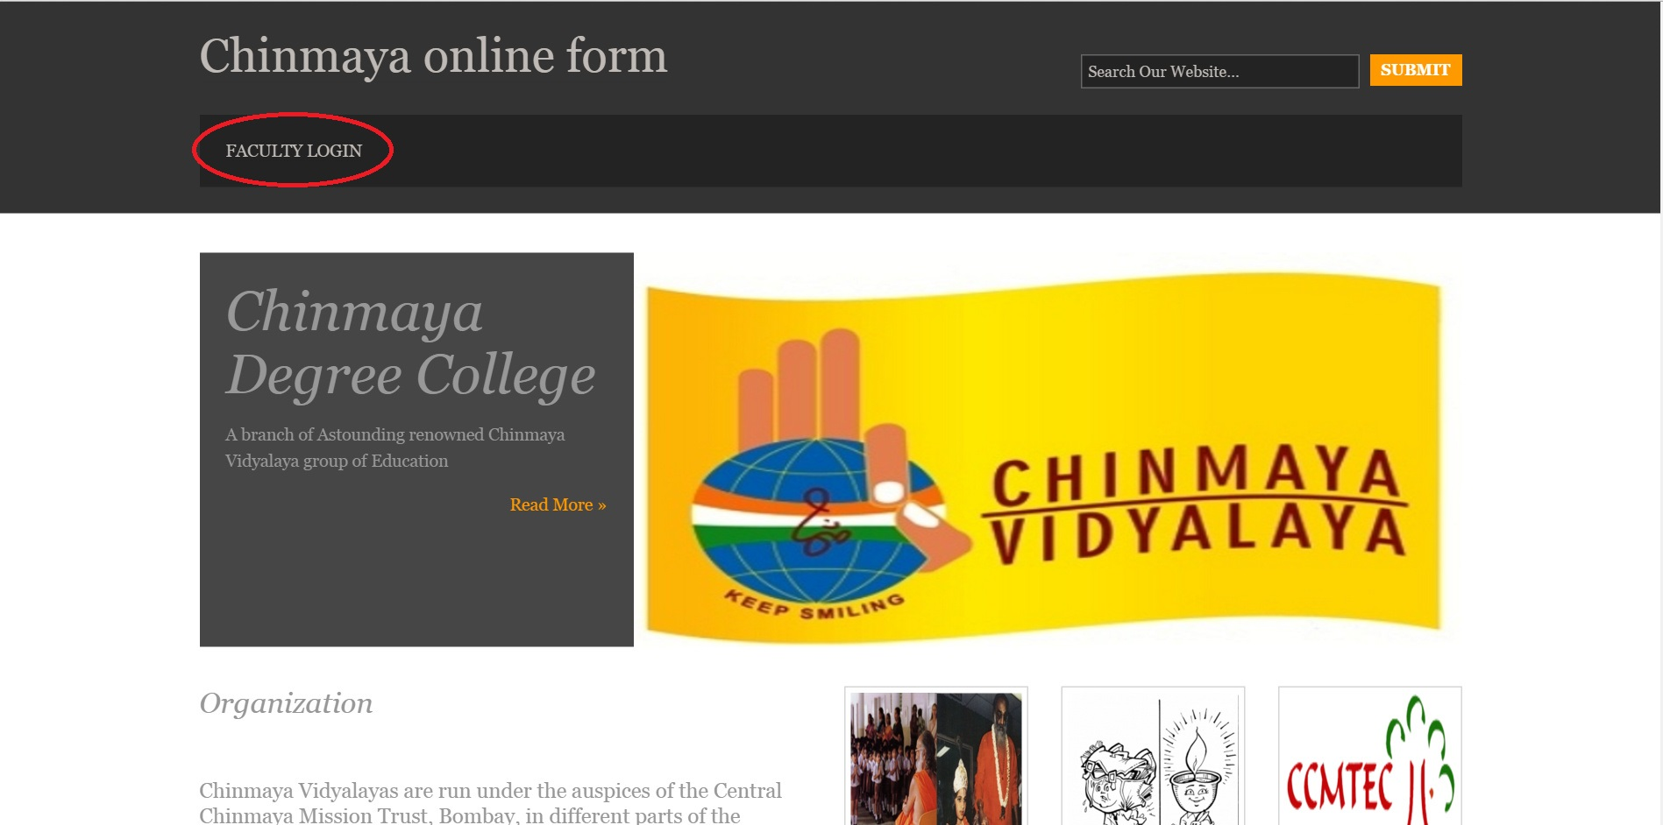
Screenshots of the application

Slide 13
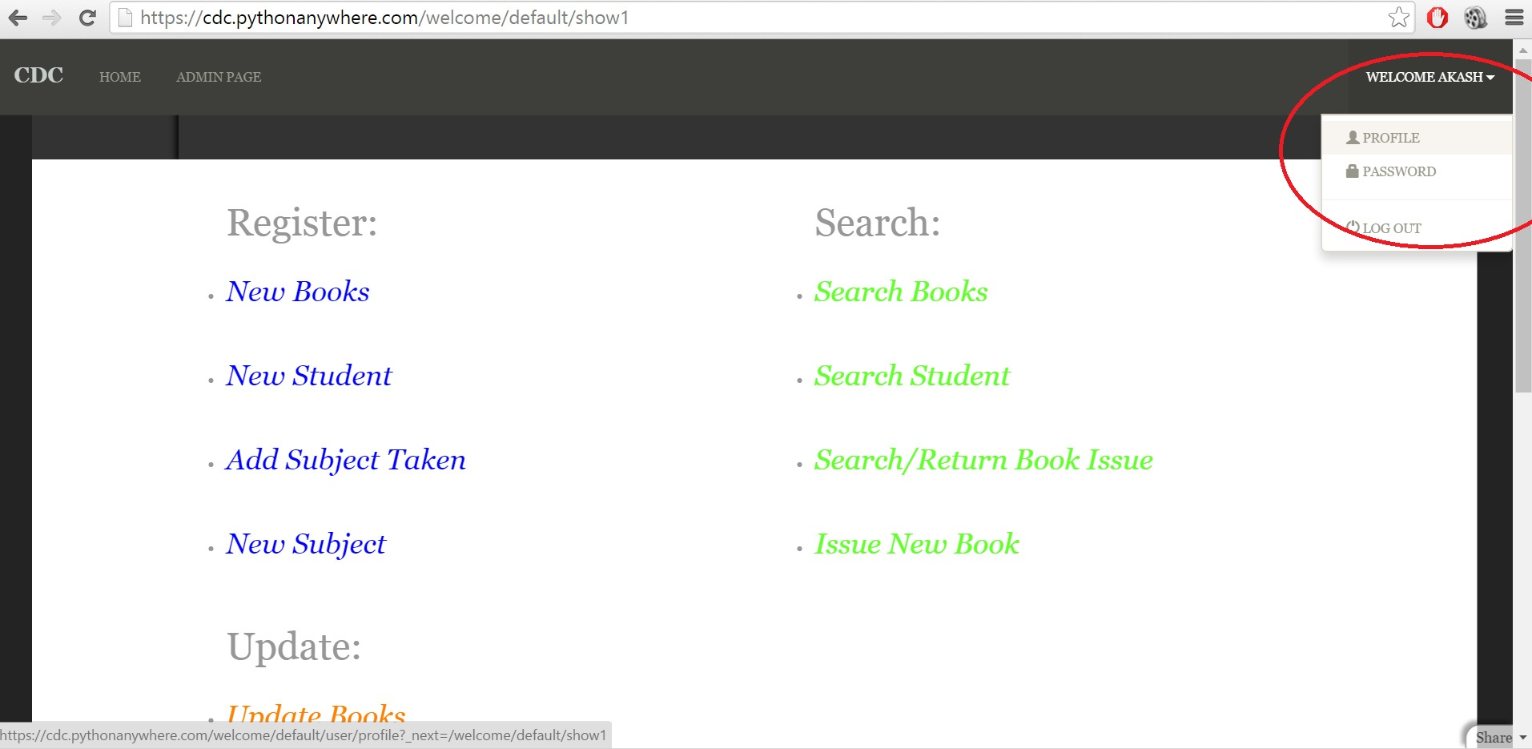
Screenshot 1.1

Slide 14
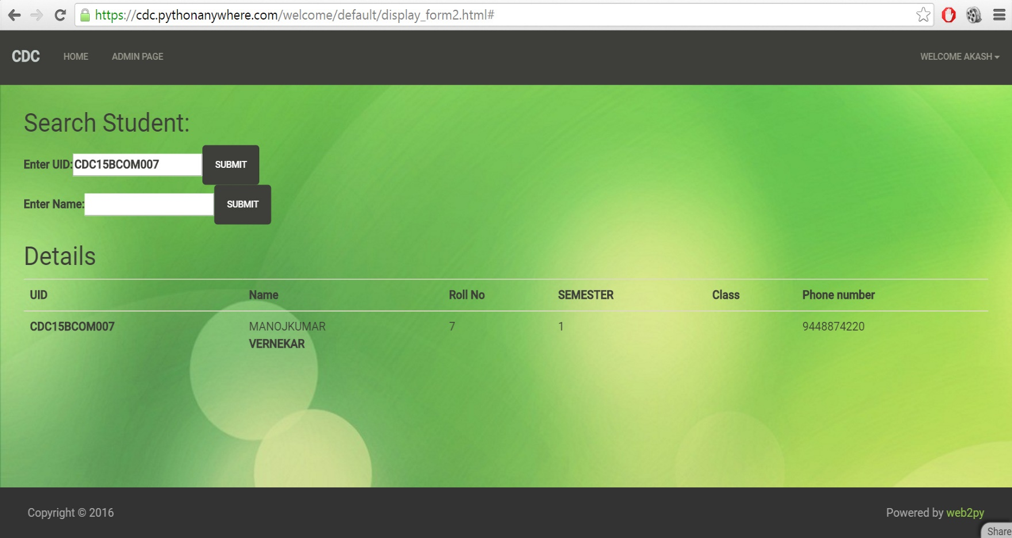
Screenshot-2

Slide 15
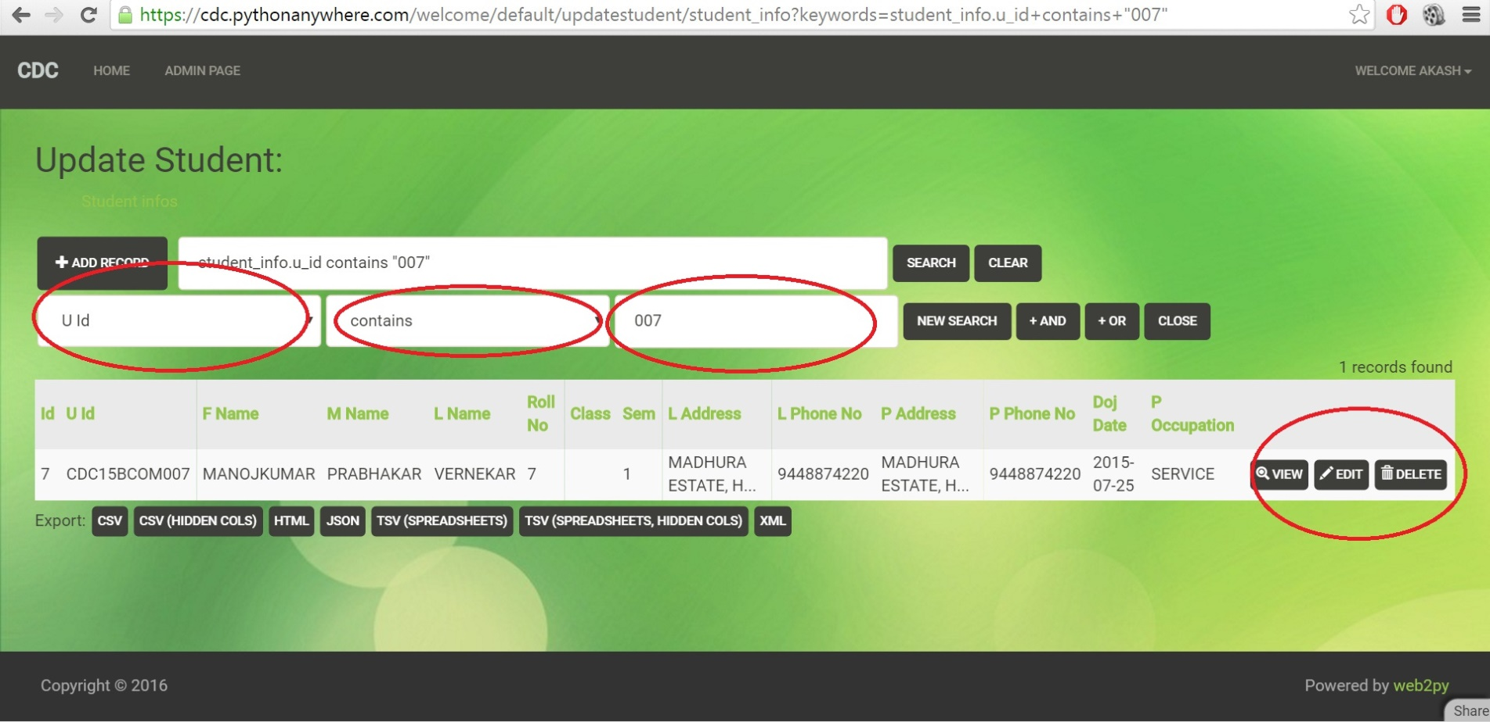
Screenshot 3

Slide 16


